Slide 1
The Appeals Process & Hearings
By: David Huntimer

Slide 2
What To Do If A Benefits
Claim Is Denied
If a VA benefits claim is denied, the claimant has the right to appeal the decision
Currently, there are 3 decision review options to choose from, which will be discussed later in this class, and they are
  1. Higher Level Review
  2. Supplemental Claim
  3. BVA: 3 Avenues for BVA
Notes:
The 3 BVA lanes are Direct Review, Evidence Submission and Hearing in front of a Judge.

Slide 3
Examples Of Appealable Decisions
Character of Discharge/Status as a veteran
Service connection
Rating percentage
Effective date
Dependency & Indemnity Compensation
Waiver of overpayment
Entitlement to special monthly compensation/pension
Medical payments and equipment eligibility
Notes:
This list is NOT all inclusive! Other….education, home loans, special clothing allowance, etc.
Be careful with some appeals. For example, if you appeal an effective date, that opens the whole claim up for review. Do you want to risk a 100% P&T just to gain a couple months of retro?

Slide 4
Actions That Can Not Be Appealed
Proposed actions – the most common are reductions of ratings and ratings of incompetency
Proposed actions are not a “final” decision - All final decisions should include appeal rights in notification letter
Notes:
ASK STUDENTS – when can these actions be appealed? (Answer: Once the proposal becomes final.) You can respond to a proposed action. If you do, you need more than just I disagree. Need evidence to back up why you disagree. This would be typed up in a 4138 which can be submitted with evidence. This is time sensitive.

Slide 5
Appeal Timelines
Indication that the veteran disagrees with a decision must be filed within ONE YEAR from the date of the decision notification for all claims, other than contested claims 38 CFR 19.52(a)
If it is time-stamped within the appeal period, it is considered TIMELY. (This is postmarked or received at the VA, NOT when it is received at the regional office)
For appeal periods ending on weekends or holidays, the next working day marks the end of the appeal period 38 CFR 20.110(b)
Notes:
Do not wait until the last minute to send an appeal. If needs immediate attention, make sure you are marking it as such when submitting the pack and contact someone in the office. The office closes at 1630, so please keep that in mind when sending time sensitive packs.

Slide 6
Board Of Veterans Appeals
Decision Outcomes
Once a hearing is held or an appeals consultant prepares a brief, the Board will review the appeal and issue a decision
“Grant” means an issue was granted in full
“Remand” means development is needed, sent back to RO/AMO for development, and a new decision is made.
  If legacy appeal, and SSOC is issued, the appeal will return to the BVA
  If a modernized appeal is filed, a new rating decision will be issued, and the veteran can choose from three options
“Deny” is self-explanatory: options for challenging the denial are explained on the following slide
Notes:
SSOC: Supplemental Statement of Case
Just to clarify: If the Remand is a legacy case, the remand is sent back to the board with the SSOC and the board decides. If the case is AMA, then the RO renders a decision and sends it out in a Notification Letter.
AMO: Account Management Office

Slide 7
Challenging A Decision By The
Board Of Veterans Appeals
Appeal to the Court of Appeals for Veterans Claims (CAVC):
  120-day deadline from the decision notice to file NOA with the Court
  Federal Court: service officers cannot represent unless they are also attorneys barred at the CAVC
  Suggest the veteran obtain a veteran's benefits lawyer –provide contact info for Bergmann & Moore and Veterans Consortium Pro Bono Program, but do not recommend a specific lawyer. Unlike at the VA, where lawyers usually charge veterans a fee, many lawyers will represent for free at CAVC – attorney fees paid by the government if successful (EAJA)
Notes:
These two firms are contracted with the American Legion and the VFW.

Slide 8
Appeals Process
APPEALS MODERNIZATION ACT

Slide 9
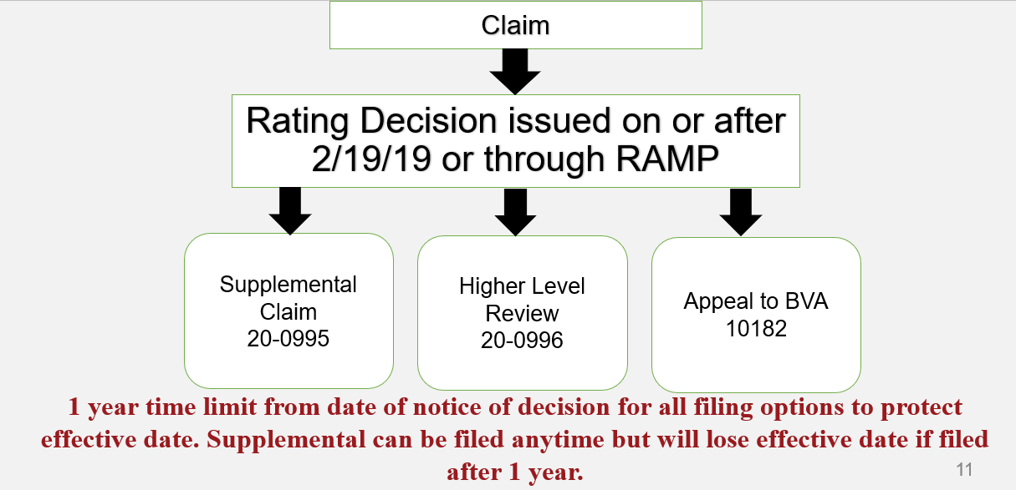
AMA Decision Review Options
Notes:
Higher level review and appeal to the BVA must be completed within a year of notification letter. A supplemental can be done anytime you have new and relevant evidence but if filed within the year will preserve the effective date.

Slide 10
“Closing the record”
Under AMA, the evidentiary record that VA is obligated to consider “closes” at the time of the rating decision
  Evidence submitted after the rating decision will not be automatically considered: must select the decision review option that allows submission of evidence
  Evidence submitted before the rating decision but not considered by VA: select the decision review option based on the same evidence to have it considered
    Creates a quality feedback mechanism: if the claim is granted based on the same evidence, there was an error
Notes:
Bullet 1: If you want any evidence considered after a decision, it will have to be submitted with an 0995 to reopen the case.
Bullet 2: Once the claim goes to Ready For Decision in the system, any evidence submitted after may not be considered.

Slide 11
Closing the record and VA’s
Duty to Assist
VA’s duty to assist is only triggered by evidence submitted before the initial claim OR before each supplemental claim decision.
If VA did not take adequate steps to assist the veteran, it can be raised through higher-level review or BVA
  VA will return to the supplemental claim lane, or BVA will remand for additional development if VA did not comply with the duty to assist 38 CFR 3.159(c)
  If additional evidence is submitted at BVA (through evidence only or hearing dockets), it will not trigger the duty to assist. However, VA can still grant or deny based on the additional evidence.

Slide 12
AMA: 3 Decision Review Options
38 CFR 3.2500
  Supplemental Claims (Form 20-0995)
  Higher Level Review (Form 20-0996)
  Board of Veterans Appeals (Form 10-182)
Claimants can pursue only one decision review option at a time for the same claimed issue
There are no limits to the number of times a veteran may pursue a claimed issue
Notes:
So, as long as it is done properly and with new evidence, there is no limit on how many times a condition may be put in for. Also, as long as there is continuous pursuit within the timelines, the date of initial claim is preserved.

Slide 13
AMA: Supplemental Claims
38 CFR 3.2501
Requesting a new rating decision from VA based on the submission of “New and Relevant” evidence (Form 20-0995)
If filed within one year of VA issuing a rating decision, Board of Veterans Appeals Decision, or CAVC Decision, protects the effective date of the claim
Claimants can perpetually file supplemental claims on the same issue, provided they satisfy the “New and Relevant” criteria
Submission of new and relevant evidence triggers a duty to assist
Can also be used for denial based on a missed C&P exam as long as there is an explained reason for the missed exam.
Notes:
If you are doing an 0995 for a missed exam, you need to do a 4138 explaining why the veteran missed the exam and request a new one. The veteran needs a valid reason for missing the exam. It can’t just be because he didn’t feel like going or didn’t like the examiner. Those are issues that should have been dealt with as soon as it was scheduled.
CAVC: Court of Appeals for Veterans Claims.

Slide 14
Supplemental Claims: New and Relevant Evidence
What is “New and Relevant?” - 3.2501(a)(1)
  “New” means it is not already in the veteran’s claim file
  “Relevant” means it is pertinent to the benefit sought and reason the benefit was previously denied (even if not favorable to the claimant: lower threshold than “material”)
Example:
Red Foreman is claiming his diagnosed ischemic heart disease is the result of exposure to herbicides while serving in Korea in 1970. His claim for service connection was denied because his military service records did not indicate that he served in a unit in or near the Korean demilitarized zone. VA concedes that he has a diagnosis of ischemic heart disease.

Slide 15
Supplemental Claims: New and Relevant Evidence
Which of these are “New and Relevant?” (assume not in file)
Buddy statements from those who supervised Mr. Foreman while serving in Korea and witnessed him on the DMZ.
Doctor’s notes confirming that Mr. Foreman has a diagnosis for ischemic heart disease
Spouse statement documenting the effects of ischemic heart disease on Mr. Foreman’s daily life
Photos of Mr. Foreman in Korea alongside defoliated areas or signs/landmarks indicating he was physically present at the DMZ
Notes:
Bullets one and four are New and Relevant. Bullets two and three are not as the VA has conceded that he has the disease.

Slide 16
Supplemental Claims: New and Relevant Evidence
This Evidence discussion can be applied to appeals and to new cases.
When submitting articles, they need to be the entire research article, not just a link. The VA has a duty to look at all evidence, but that does not carry over into looking up or researching non-submitted evidence.
BVA cases are not precedent-setting. Only Court of Appeals cases set precedent.
Notes:
1. Go to H: drive and show the research article and go through who its from, who wrote it, lay out and research done at end.
2. Go to H: drive and show the BVA case decision then show the Court of Appeals decision.

Slide 17
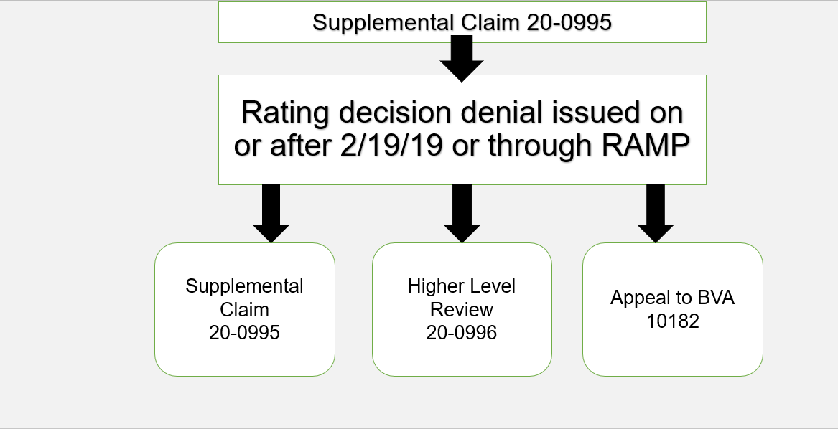
Post-Supplemental Claim
Decision Review Options
Notes:
If you get a decision on a supplemental claim, you have the choice to file another supplemental claim with new and relevant evidence, request a higher level review or appeal to the BVA.

Slide 18
Higher Level Review
38 CFR 3.2601
A detailed VA Form 21-4138 should be completed with all higher-level reviews explaining what evidence you want the higher-level reviewer to consider.
Review is solely on evidence of record – cannot submit additional evidence
Decisions can be overturned based on a difference of opinion or CUE
Can only be requested within one year of a notice of a rating decision
An informal conference with the reviewer can be requested
Notes:
An informal conference is very informal and is a chance to tell a reviewer why you think the decision was wrong and you can point out evidence already in the file that you feel may not have been given proper weight. This can also be done by typing up a 4138 with an explanation and skipping the Informal Conference.

Slide 19
Higher Level Review
When to use
Decision will be much quicker than an appeal to the BVA
When you can articulate with the evidence from the file that the rater made an error.
Side Caveat: A rater can go with what a C&P examiner recommends, or they can go one up or one down on the percentage. A rater can also deny, even if the Examiner gives a positive exam. They need to articulate why they made the decision in the decision narrative.

Slide 20
Higher Level Review Example
Example:
Johnny Utah claimed service connection for fibromyalgia related to service in Southwest Asia in 2005. He was diagnosed with fibromyalgia in 2011, three years after he separated from the military. Johnny completed an exam for fibromyalgia that sufficiently demonstrates his current level of impairment, and the DBQ is in his record, along with his service records and his 2011 diagnosis.
However, VA denied service connection based on the lack of a diagnosis of fibromyalgia while in service.
What are some reasons Johnny might consider Higher Level Review?
Notes:
Gulf War presumptive.
We consider these undiagnosed illnesses presumptive if you served in a recognized location, a health care provider diagnosed you while you were on active duty or at any time after separation, and you’ve been ill for at least 6 months:
Chronic fatigue syndrome
Fibromyalgia
Functional gastrointestinal disorders
Medically unexplained chronic multisymptom illness
Other undiagnosed illnesses, such as cardiovascular signs and symptoms, muscle and joint pain, and headaches

Slide 21
Higher Level Review Example
Why could Johnny request HLR?
Fibromyalgia is a presumptive condition for Southwest Asia service
Johnny’s military record indicates that he has qualifying Southwest Asia service in Iraq in 2011
Johnny has had a current diagnosis of fibromyalgia for more than six months
Johnny’s exam indicates that the condition is compensable at a rate greater than 10%
VA misinterpreted the presumption, which dictates that the condition must have emerged while serving in Southwest Asia OR by December 21, 2021.

Slide 22
Higher Level Review Decision
38 CFR 3.2601(g), 3.2502
  Decision can deny, confirm, and continue benefits
  Decision can grant benefits
  The decision can propose to reduce benefits
  Decision can send claim to supplemental claim lane for additional development

Slide 23
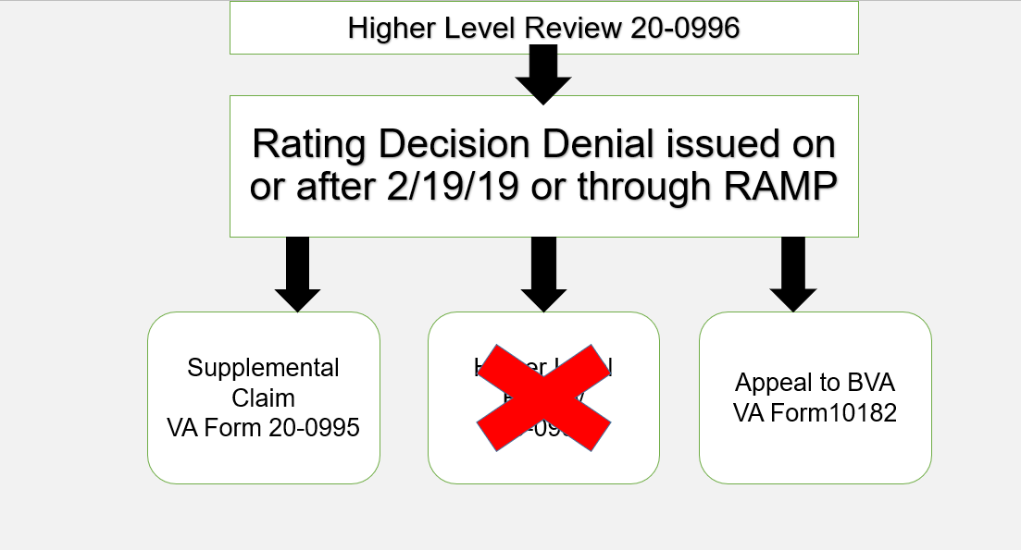
Post- Higher Level Review Decision Review Options
Notes:
On a higher-level review decision, you only can go to routes with the denial. You can do a supplemental claim or take it to the BVA.

Slide 24
Appeal to Board of Veterans Appeals
38 CFR 20.202
Under AMA, the NOD (VA Form 10182) is filed directly with the BVA
There are three separate BVA dockets:
  Direct Review docket with no introduction of new evidence
  Evidence Only docket with limited window introduction of new evidence (90 days after NOD)
  Hearing docket with limited window for introduction of new evidence (at hearing or up to 90 days after hearing)
Notes:
Bullet 2: The evidence cannot be submitted with the 10-182. It must be submitted after you receive the letter saying that the Notice Of Disagreement has been received.
Bullet 3: The new evidence can be submitted at the time of the hearing or up to 90 days after the hearing. If you have no additional evidence, you can waive the 90-day window and request a quicker decision.
if a veteran wants to submit evidence directly to the BVA and the evidence submitted would not result in an outright grant but would instead raise additional development, it should instead first be submitted as a supplemental claim to force VA to comply with DTA

Slide 25
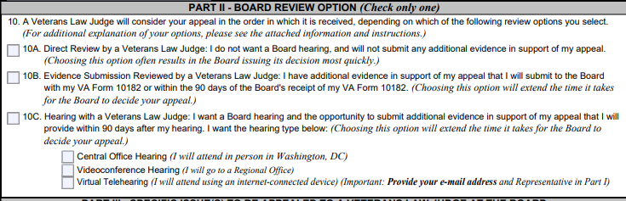
VA Form 10-182
Notes:
With the current guidance from the BVA, when selecting a hearing, always select under block 10C: Virtual Tele hearing.

Slide 26
Tips on VA Form 10-182
Appeals submitted directly to BVA (especially on the direct docket) must be researched fully
VA Form 10-182 should have at least a VA Form 21-4138 attached with a well-thought-out argument. (Especially if you are going with Direct Review or Evidence Submission)
Ensure only one docket option is selected – if you want to select different dockets for different issues, complete separate VA Form 10-182s.

Slide 27
Clarification of VA Form 10-182
If BVA asks for clarification of the issues or the docket selected on a NOD, the claimant has 60 days or the remainder of the one-year appeal period to respond (whichever is longer)
This is crucial, because if the claimant does not respond, VA will not establish or will close out the appeal
Notes:
If the Appeal closes out or goes past the one-year mark, the only way to re-open the claim is with an 0995 and new and relevant evidence.

Slide 28
Docket Dates
Once sent to the BVA, the case will receive a docket date, which is based on the date the claim is certified to the BVA
With limited exceptions, the BVA works cases in docket date order
BVA publishing “appeals metrics” on their public website: https://www.bva.va.gov/Appeals_Metrics.asp
Notes:
Bullet 2: You can request an advancement on the docket due to age, health, homelessness or special circumstance. If your case is advanced on the docket and it is Remanded back to the Regional Office, the advancement does not follow it. You would have to send a request to the RO to have the case expedited.

Slide 29
Expediting Appeals At The
Board Of Veterans Appeals
Advancement on the Docket can be done after the case is “certified” to BVA – call our office and they will file a motion if the veteran is seriously ill, has severe financial hardship, homelessness, or is of advanced age (75+), and for exceptional circumstances (such as areas affected by severe natural disasters)
If the case is REMANDED back to the Regional Office, the Advancement on the Docket does not follow the case. If the Veteran qualifies under the VA standard, you will need to fill out VA Form 20-10207 Priority Processing Request.
Notes:
The 20-10207 must be sent to the VA not the BVA.

Slide 30
Switching Dockets
You can switch dockets at the BVA by filing a new VA 10182
Time limit: within the original one year from the rating decision, or 60 days after the first 10182 filed, whichever is later (38 CFR 20.202)
If switching to an evidence-only docket, 90 days to submit evidence starts from the date the request to switch dockets is granted.
Once evidence is submitted or a hearing is held, you cannot switch to the direct review docket
    Why? You have changed the evidentiary record, and VA can’t “un-see” the evidence or testimony
    38 CFR 20.301, 20.302, 20.303

Slide 31
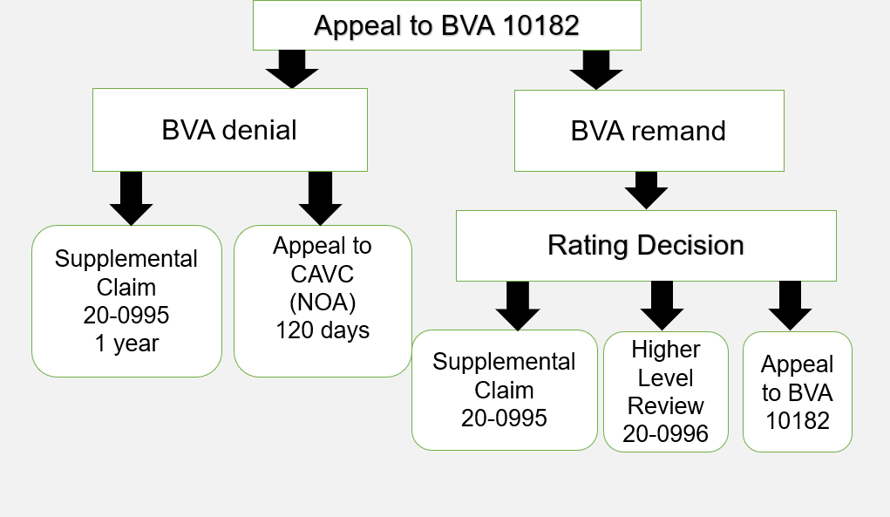
Post-BVA Appeal
Decision Review Options
Notes:
Remands will not automatically return to the BVA if denied. A rating decision will be issued, and any issues denied that claimant disagrees with, can select any of 3 options.
Will not retain original docket number.
REMEMBER: If the veteran wants to take the case to the CAVC, they only have 120 days from Notice to file the claim. Also, we cannot represent them at the CAVC. They will need to get their own lawyer or use one of the two firms used by the American Legion and VFW.

Slide 32
HEARINGS
A hearing is a meeting between a claimant and the VA
Although many veterans believe that this is their “Day in Court”, hearings are non-adversarial in nature and are intended to help VA reach an accurate decision

Slide 33
During the Hearing - Witnesses
Veterans will often want to bring a witness to their hearing. Witnesses can include:
                Spouse
                Friends
                Doctors
                Other family members
  **Lawyers, other representatives, and media members are NOT allowed to be present in the hearing unless they are only acting as a witness**
Notes:
The only people allowed to talk during a BVA hearing is the Veteran and the Veterans Representative. The only exception is if the veteran has an interpreter. If the veteran has a spouse with them, on occasion, the Judge will ask if they have anything to say. The Judge can do that.
We need to keep the discussion to the topic of the appeal.

Slide 34
Cancelling Hearings
If you are able to get the issue on appeal resolved without having the hearing, by all means do so
Cancelling the hearing will often allow the claim to be resolved more quickly than if the hearing were to take place
When cancelling a hearing, be sure to get the request in writing from the veteran because cancelling a hearing without written consent is considered withholding evidence!
There is precise wording that must be used when cancelling a hearing.

Slide 35
Change Of Representation At BVA
38 CFR 20.1305
VA allows changes in representation up until 90 days after the appeal is received by the Board of Veterans Appeals
Any change in representation must be sent to the BVA for approval. They can deny the change, and the representation will stay
Remember to ask new veterans to your office if they have any outstanding BVA decisions. If they do, we cannot take POA until that decision process is complete.

Slide 36

Questions

